Slide 1
Fuel Types Continued
NE 533 Spring 2024

Slide 2
Last Time
Course overview
My view of fuel performance
heat delivery to coolant, length of operation, tolerance to accidents
Considerations for fuels
Why not pure U?
Intro to UO2 fuels for LWRs

Slide 3
Mixed Oxides (MOX)
Can be combined with PuO2 for a mixed oxide (MOX) fuel for use in fast reactors
Allows to burn excess weapons grade plutonium
About 30 reactors in Europe currently utilize a partial MOX core
Similar behavior to UO2, but different neutronics, fission gas release, thermal conductivity, etc.
Less common is inclusion of minor actinides in MOX to burn waste

Slide 4
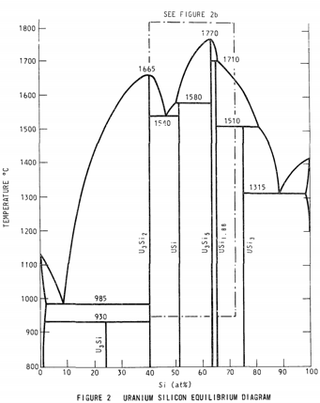
Accident Tolerant Fuel
USi fuels (U3Si2)
A metal-ish compound, with higher thermal conductivity, higher uranium density
Complex crystal structure (10 atoms unit cell) with effectively two sub-lattices
Amorphizes at low temperatures
Poor oxidation resistance
Will require improved cladding, liners/coatings or fuel dopants

Slide 5
Accident Tolerant Fuel
Cr-doped UO2
Larger grain size, theoretically reduced fission gas release
Cr changes the O potential present within the fuel, changing defect concentrations and mobilities
Coatings or alternate claddings – FeCrAl or SiC
Improved radiation resistance, corrosion resistance, etc.

Slide 6
Uranium-Zirconium (UZr)
Utilized in sodium cooled fast reactors (SFRs)
EBR I, EBR II
Varied crystal structure and compositional environment
Easily alloyed with Pu, minor actinides (MA)
Can function as a breeder/burner fuel
Sodium coolant
Fe-based cladding

Slide 7
Uranium-Zirconium (UZr)
Alloy metallic U with Zr to increase the melting point and to stabilize the high temperature body-centered cubic phase
Interesting phenomena
30-50% swelling
Constituent redistribution
Alpha tearing
FCCI

Slide 8
Uranium-Zirconium (UZr)
Good Characteristics
High thermal conductivity
Stability to high burnups (> 20%)
Flexible composition
Inherent safety- negative reactivity feedback
Good compatibility with Na coolant
Bad Characteristics
Low melting point
Dramatic fuel swelling that must be accounted for
Incredibly complex microstructures/unpredictable behavior
Fuel-Clad Chemical Interaction
Very easily oxidized

Slide 9

Uranium-Molybdenum (UMo)
New fuel being qualified for research reactors
Fuel foil, with Zr diffusion barrier, Al cladding
Will be utilized in ATR, NBSR, MITR, MURR

Slide 10
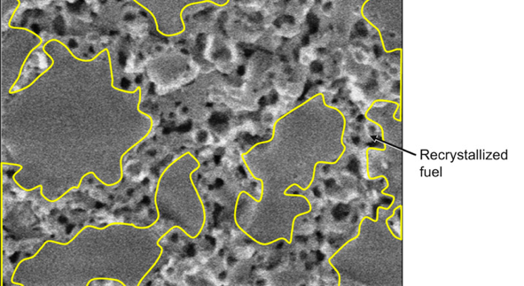
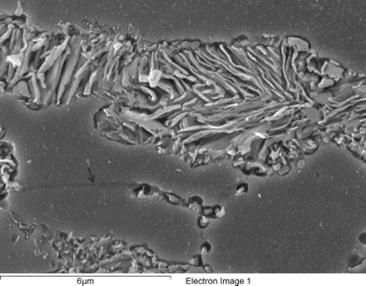
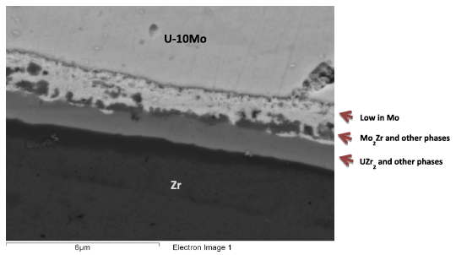
Uranium-Molybdenum (UMo)
Microstructural phenomena of interest:
Decomposition
Fission Gas Superlattice
Recrystallization
Inter-diffusion region
Carbides

Slide 11
UC/UCO TRISO Fuels
TRISO: TRistructural ISOtropic particle fuel
Layered fuel in mm-sized particles
Layers:
Fuel Kernel
Buffer
Inner Pyrolitic Carbon (IPyC)
SiC
Outer Pyrolitic Carbon (OPyC)

Slide 12
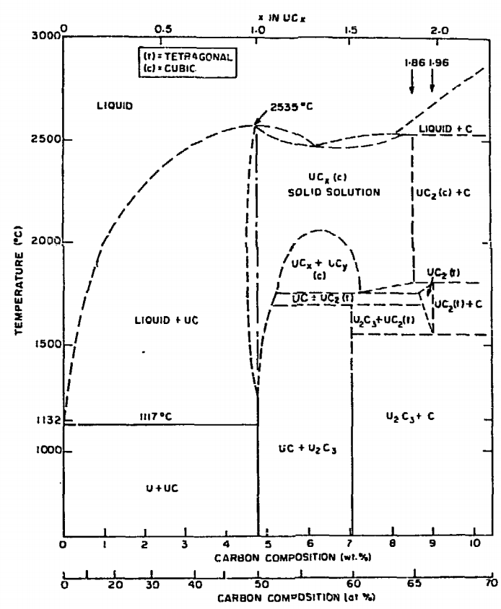
UC/UCO TRISO Fuels
Can appear as UC, U₂C₃, or UC₂
Advantages
High thermal conductivity
High fuel density
Thermally stable
High melting temperature
Disadvantages
Rapidly corrodes in water
Reacts with some cladding

Slide 13
UC/UCO TRISO Fuels
High temperature gas reactors (HTGR) or molten salt reactors (MSRs)
Pebble bed and prismatic types
Particles are agglomerated with graphite into a larger pebble, or into a cylindrical block
Current designs utilize UCO, which is a heterogeneous mixture of UO2 and UC fuel
Helium cooled gas or molten salt cooled

Slide 14
UC/UCO TRISO Fuels
Each individual pebble acts as its own containment, and allows fuels to go to much higher burnups and higher temperatures than UO2
Highly reliant on accurate fabrication processes that create high integrity, uniform layers and spherical particles
Integrity of the SiC is key for fission product retention

Slide 15
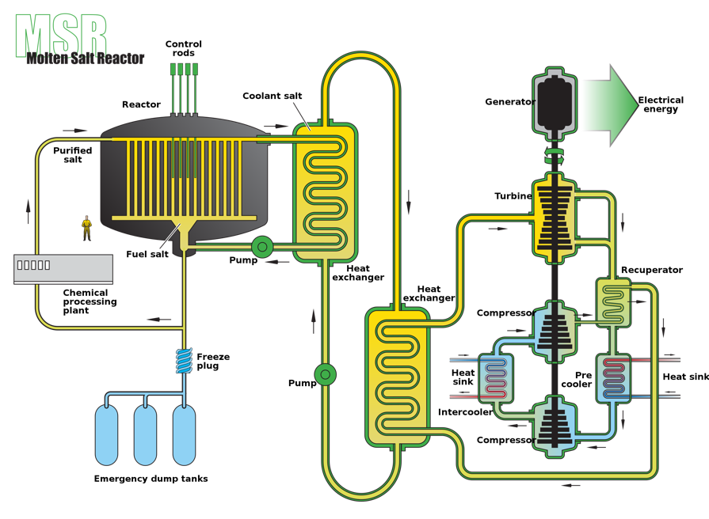
Molten Salt Reactors
Molten Salt Reactor
Utilizes flowing fuel salt (i.e., UF4-ZrF4-KF) with a secondary molten salt coolant loop (FLiBe)
MSRE at ORNL, some modern designs
Stable Salt Reactor
Utilizes fuel that is dissolved in molten salts (NaCl-(U/Pu)Cl3), contained in rods
Molten salt coolant (NaF-ZrF, FLiBe, FLiNaK, etc.)
Can mix other actinides into the fuel in order to burn waste
Designed to be inherently safe
Molten salt corrosion is a big problem, as well as the lack of information on thermophysical properties of complex salt

Slide 16
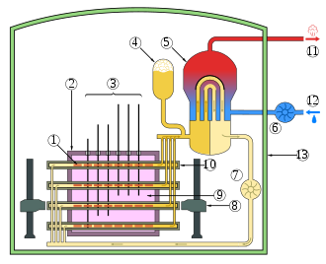
CANDU Reactors
Canada Deuterium Uranium: pressurized heavy water reactor
Natural uranium, as UO2, as the fuel source
Heavy water is the coolant, has a lower absorption of neutrons
Fuel pins are horizontal, as opposed to vertical
CANDU can be refueled online
Removes costs associated with enrichment

Slide 17
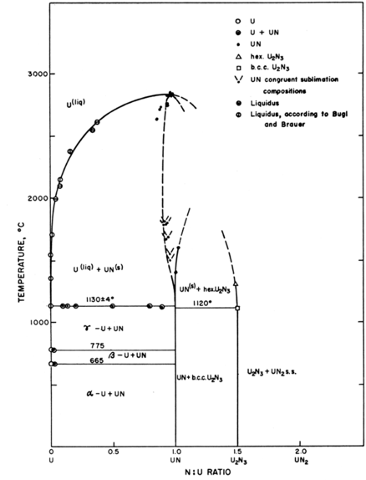
UN – Lead Cooled Reactors
Can appear as UN, U₂N₃, or UN₂
Advantages
High thermal conductivity
High fuel density
Thermally stable
High melting temperature
Disadvantages
Corrodes in water
Reacts with some cladding
Difficult to manufacture
Requires N-enrichment
Pb or Pb-Bi coolant
Operates in the fast spectrum

Slide 18
Unique Fuel Designs
Lightbridge
High Zr content UZr alloy
Cruciform geometry fuel rods, combined into fuel elements
Kairos
TRISO particle compacts with low density core
Float in molten salt coolant for online refueling
NASA/LANL
UMo fuel for space reactors: KRUSTY

Slide 19
Fuel Summary Table
Property | UZr | UO₂ | UC | UN | U₃Si₂
Corrosion resistance in water | Very poor | Excellent | Very poor | Poor | Very Poor
Compatibility with clad materials | Reacts with normal clad | Excellent | Variable | Variable | Variable
Thermal stability | Phase change at 665 and 770 °C | Good | Good | Good | Good
Uranium (metal) density (g/cm³) | 19.04 | 9.65 | 12.97 | 13.52 | 11.31
Melting point (°C) | 1205 | 2865 | 2850 | 2860 | 1665
Thermal conductivity (W/m-K) | 38 at 430 °C | 3 at 1000°C | 25 at 500°C | 20 at 750°C | 23 at 773°C

Slide 20

Fuel Types Summary
There exist a number of nuclear fuels in different stages of utilization and development
Each reactor design or application has individual needs, and no one fuel is one size fits all
Need to balance safety, performance (normal, off-normal, extended), manufacturability, processing, waste, etc.

Slide 21
Summary
Uranium is combined with O, C, N, transition metals for a variety of fuel types
UO2: ceramic, commercial reactor fuel, light water reactors
ATF: U3Si2 and Cr-doped UO2
UZr: fast reactor fuel
UMo: research reactor fuel
UC/UCO: high temperature gas reactors

Slide 22
Not only water-cooled reactor designs

Slide 23
Not all fuel is pellet-based
Metallic fuel is a solid fuel slug
Utilized an Fe-based cladding, such as HT-9 or SS
TRISO particles are formed into spherical compacts, or can be formed into pellet compacts
UMo and USi have been used in plate fuels
Assemblies are often hex-shaped and can included reflectors

Slide 24
ATR and HFIR Core design
HFIR combines curved plates in concentric regions
The ATR core is a unique curved design with plate type fuel

Slide 25
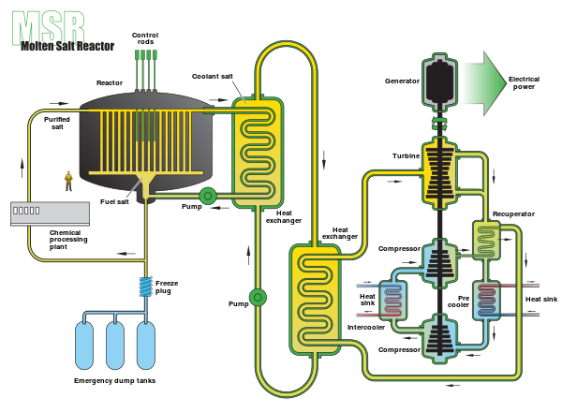
Molten Salt Reactors w/o cladding
Some MSRs plan to utilize liquid molten salts as the fuel, flowing continuously through the core
Secondary loop comprised of coolant salt, such as FLiBe
Example was the MSRE from ORNL, which utilized LiF-BeF2-ZrF4-UF4 as the fuel
Cladding is the flow piping

Slide 26
Some notes
Fast neutron cross section ~100x less than thermal neutron cross section
Fuels for fast neutron spectrum typically have high enrichments, 19.7% U-235
Historical research reactor fuels, such as UMo and USi, have had an enrichment of 90+%
Neutron flux will vary depending on the reactor
HFIR has a peak neutron flux of 3E15 n/cm²/s
PULSTAR has a peak neutron flux of 1E13 n/cm²/s
Significant variability in heat generation depending on fuel type and reactor conditions

Slide 27
Questions?

